Slide 1

Final Product Submission
Team Name: RAHI
Contest Theme: Product for Rural Entrepreneurship

Slide 2


Product Name: Onion Harvesting Machine
Team Members: 1- Bhavin Yardi
2- Atharva Shirsath
College Name: Visvesvaraya National Institute Of Technology

Slide 3
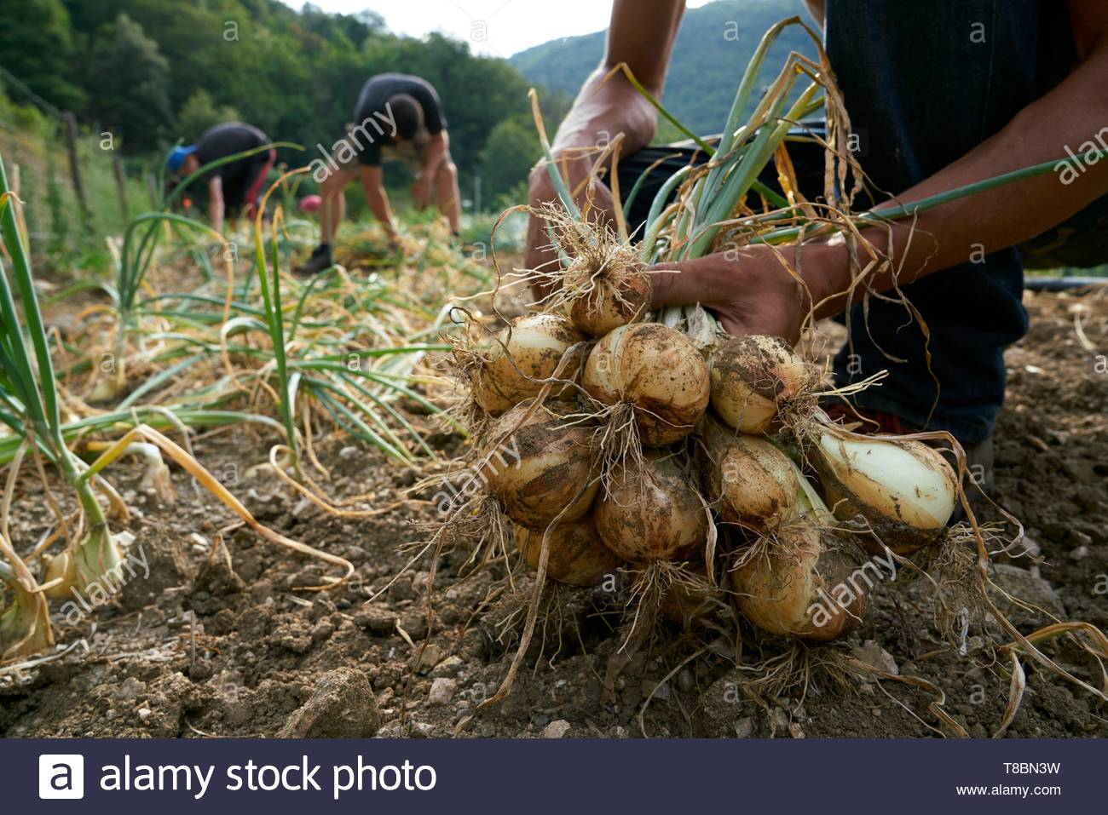
Problem Statement
Onions are the quintessential necessity of every household in every country. And, in India, not only it’s consumption, but its export is also of utmost importance. Annual turnover of Indian onion market is enormously high. In the current times, topping, the operation of harvesting to remove leaves and roots is processed by hand labor. High cost and high length of time required to process these onions add to the list of disadvantages of this operation. In addition to these, it is also becoming extremely difficult to find labor for this job. And what more, the labor that is available is so unskilled, that a fair proportion of the onions that are hand topped with this labor are non- uniform and many are damaged to the extent of being unmarketable. And, to a country that ranks 2nd in the global onion production, these problems are unacceptable. Thus, the need calls for an efficient, low cost and compact machine to help India further strengthen its control over the onion market.
Photo Credits - https://www.alamy.com/france-gard-sumene-hamlet-of-sanissas-establishment-fesquet-producer-of-cevennes-onions-labeled-aop-and-aoc-manual-harvest-image246120445.html

Slide 4
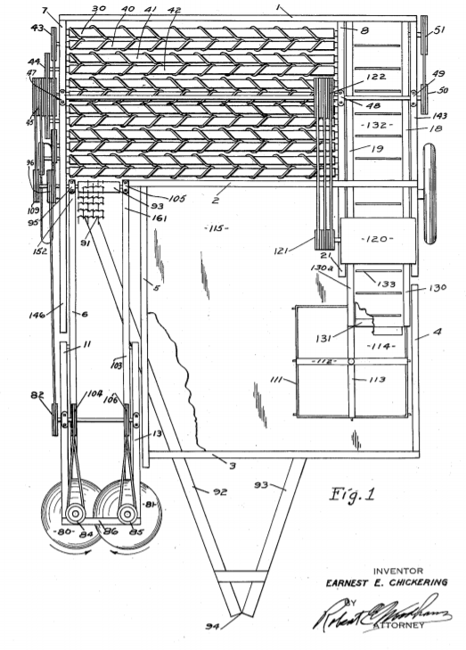
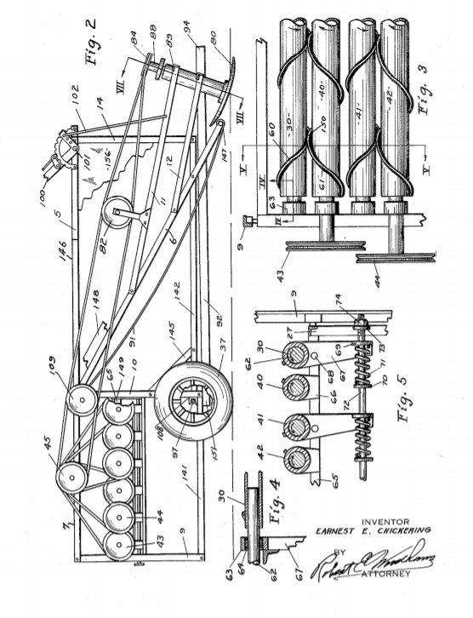
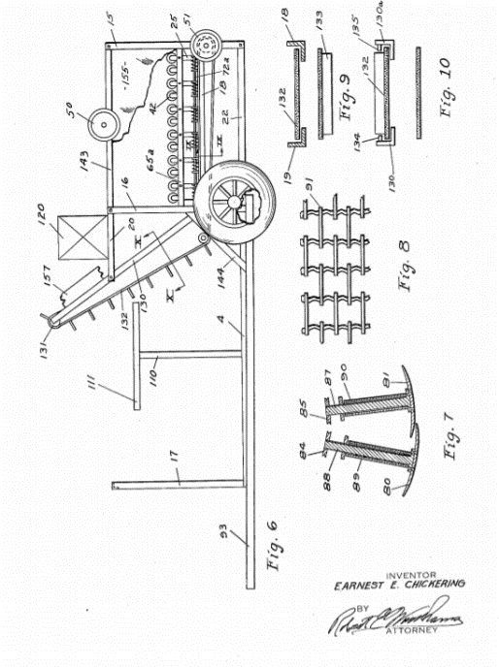
Solution available to the Problem Statement
US2531379A Harvester for onions and the like(1945) - Is largely concerned with picking them from at or near the Surface of the ground, cleaning them, separating weeds and placing them in a suitable receptacle, such as a bag or crate.
Photo Credits - https://patentimages.storage.googleapis.com/7e/aa/52/28e2734062d116/US2531379.pdf

Slide 5
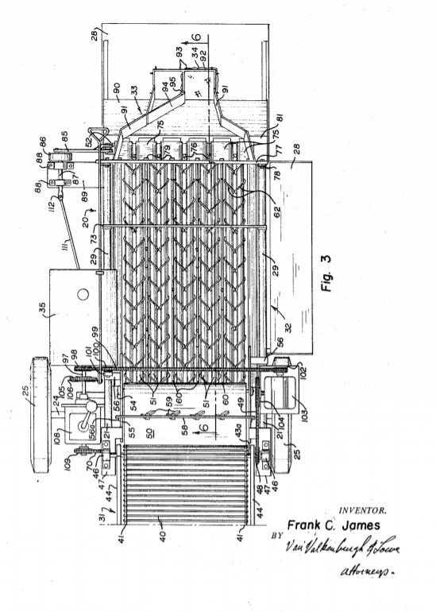
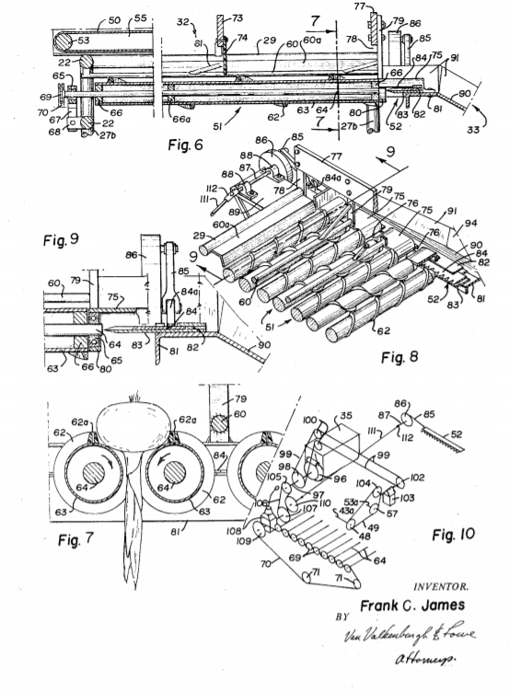
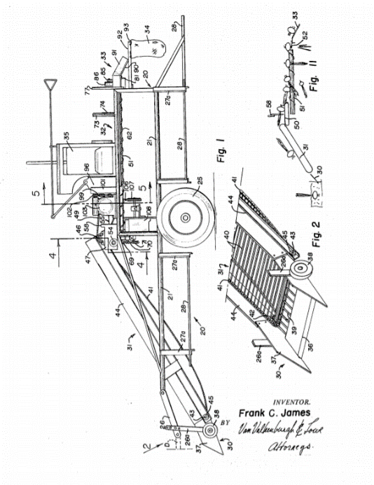
Solution available to the Problem Statement
US3451485A Onion harvesting machine (1966) - having belt to convey onion to a height and placing then on table having rolls which helps to cut leaves of onion.
Photo Credits - https://patentimages.storage.googleapis.com/82/06/e6/2e09c366dee2f8/US3451485.pdf

Slide 6
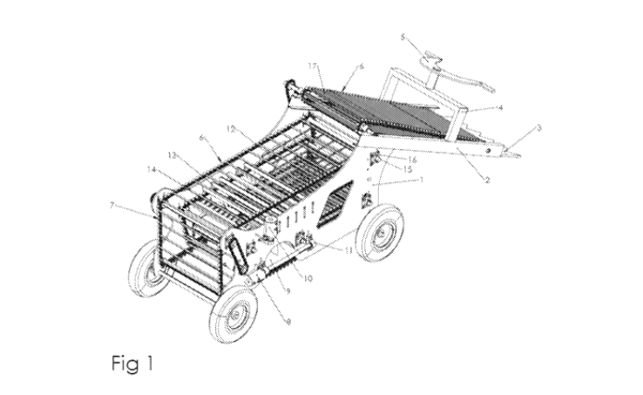
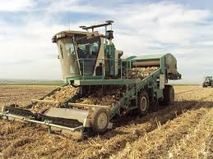
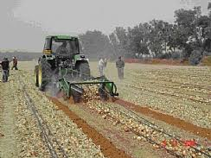
Solution available to the Problem Statement
WO2020053841A1 Onion harvesting machine with ability to cut stems (2018)- This invention is called an onion harvesting machine with the capability of cutting stems and separating clods and stones. This machine is attached to tractor and carried the power of this machine is supplied by PTO tractor.
Photo Credits - https://www.patentauction.com/patent.php?nb=15864
There are several other patents on onion harvesting. In general the present onion harvesting machines consists of conveyer belt and cutting of leaves using rotating unit like gear, razor, rolls, etc. in common.
Photo Credits - http://www.shuknecht.com/custom-onion-harvesting-equipment.html
Photo Credits - http://www.israelagri.com/?CategoryID=401&ArticleID=615

Slide 7
Market Survey
Machine Name | Machine Price | Machine Functioning
Anon diesel engine power callions and spring Onion Harvesting Machine | US $5600 - $8200 / set | Remove the Onions from ground.
Koppert Machines- Onion Harvester | €67,500 / piece | Remove the onions + Cut the leaves
Manual Labour Details -
Cost of Labor for Onion Harvesting – ₹7000 / Acre.
Time required for Harvesting – 7 days for 2.5 Acres with 12 workers.

Slide 8
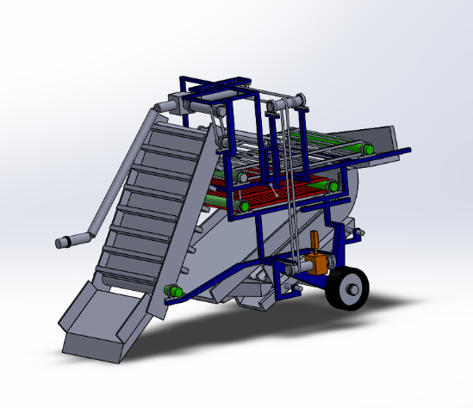
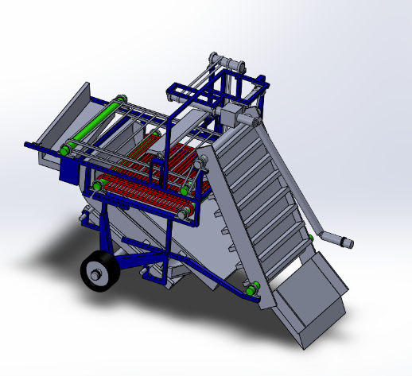
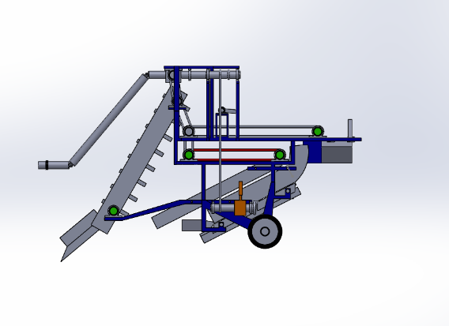
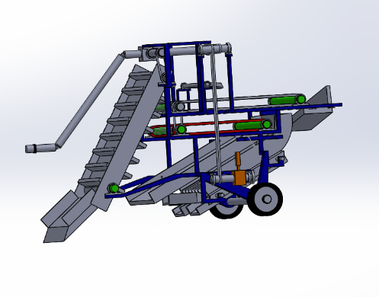
Our Solution Product
A combination of belts and rollers driven by the PTO is used for the transportation of onions across the machine. For further movement gravity has been used as a source of force to the onions. The vibration of the tractor is utilized for breaking down the soil. A series of rollers and separator is used for the separation of soil from the onions. Slider-Crank Mechanism (also driven by the PTO) is used for the cutting of leaves. The piston of the mechanism serves as a shear cutter (has blades attached to it) for the cutting. A convergent- divergent structure is used for separating the cut leaves from the onions.

Slide 9
Working of the Product
Removing Onions along with the leaves
Digger - The digger digs into the soil and does the work of plucking the onions from the soil and carrying it forward in the machine.
Belt – The Belt carries the onions with the extra soil up for further processing.
Roller 1 – The onions and the soils, then move to Roller 1, where the onions and the small lumps of soil fall down and the large lumps of soil are carried till the end and thrown away. (P.s. – The flap above the roller is provided to stop the onion above a large lump of soil from going forward).
Roller 2 – The onions and soil fall on Roller 2 and the extremely small lumps of soil fall from the roller and are eventually thrown on the ground and the onions are carried forward.
Separator – The onions and soil fall on the separator after Roller 2 and the remaining soil is separated from the onions through the grooves provided at the bottom.
Layout Assembly- The onions are carried forward and are assembled on the ground in a systematic manner because of the convergent structure provided at the end.
Roller 1 – The onions and the soils, then move to Roller 1, where the onions the small lumps of soil fall down and the large lumps of soil are carried till the end and thrown away.
Layout Assembly - The onions are carried forward and are assembled on the ground in a systematic manner because of the convergent structure provided at the end.
Roller 2 – The onions and soil fall on Roller 2 and the extremely small lumps of soil fall from the roller and are eventually thrown on the ground and the onions are carried forward.

Slide 10
Working of the Product
Cutting of Onion Leaves
On/Off Switch – After the harvesting of Onions, we store it for around 7-15 days for the curing to take place. After the curing is done, we input the onions back into the machine. This switch is used to switch on the cutting mechanism for the cutting to take place.
Transport of Onions - The harvested onions are now directly placed on the conveyer belt and travel till the separator in the same way as mentioned in Step 2,3,4 & 5 of the previous slide.
Cutter - The cutter operates on the slider crank mechanism with the blades as the piston. It keeps on reciprocating and cuts the leaves that come in contact with it through the grooves.
Layout Assemble – After the cutting of leaves, the onions come down through the separator and the leaves come down from the structure beneath it. The onions are laid down in a patch and the leaves are laid down on both sides of the onions because of the convergent-divergent structure.

Slide 11
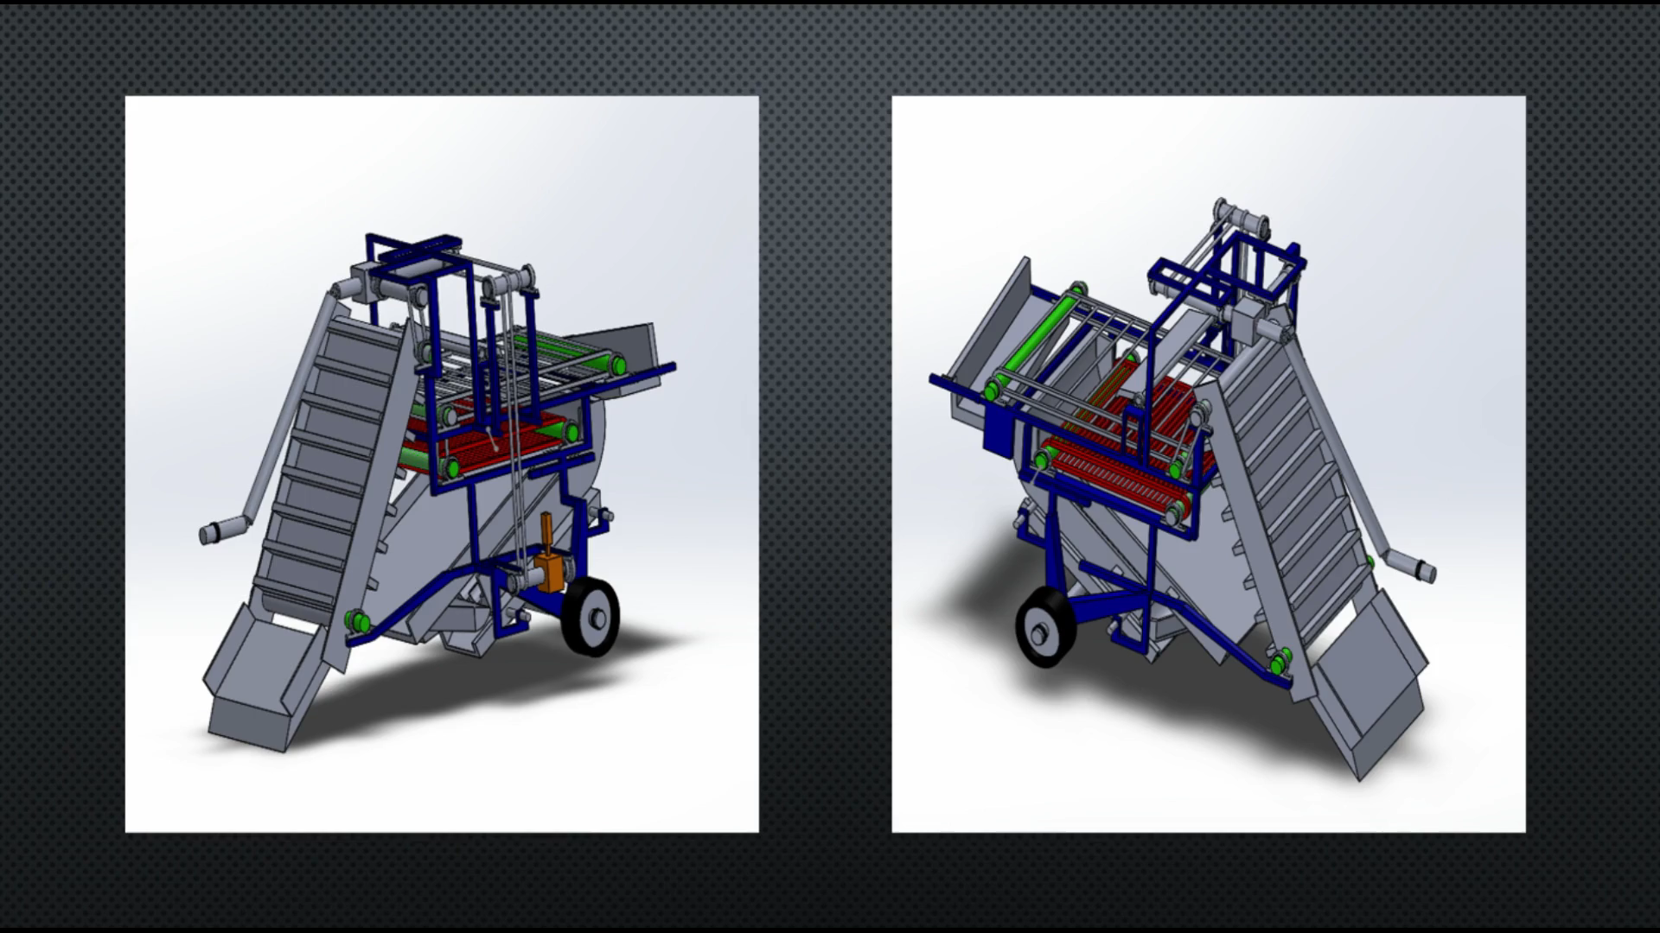
Details of the Working of the Product

Slide 12
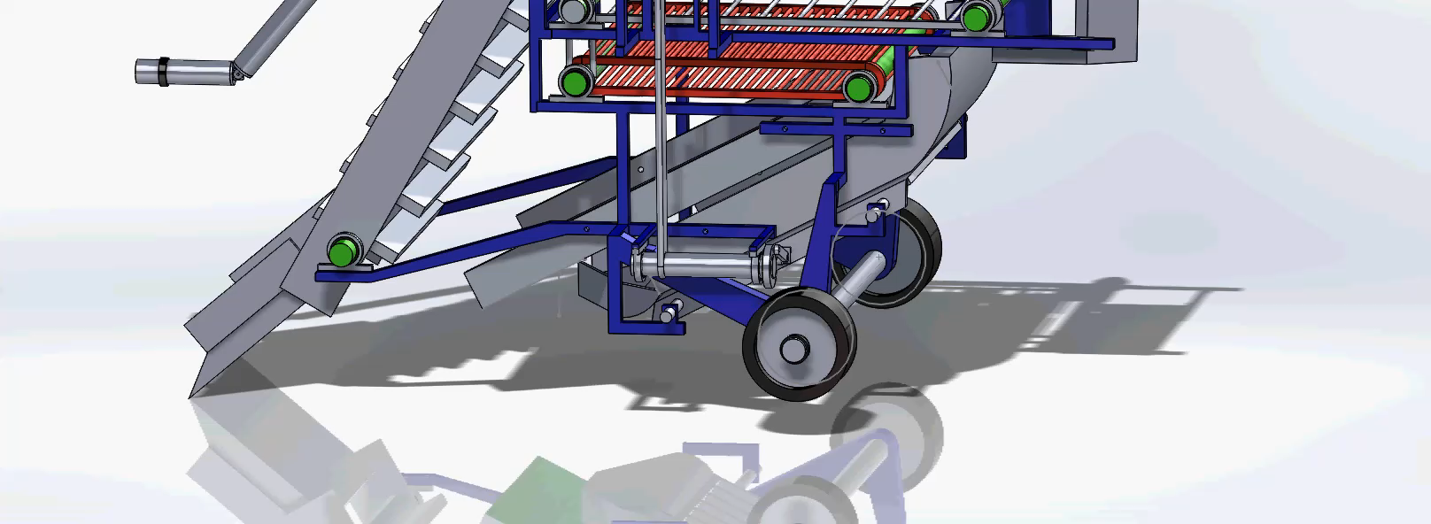
Working Simulation of the Cutting Mechanism

Slide 13
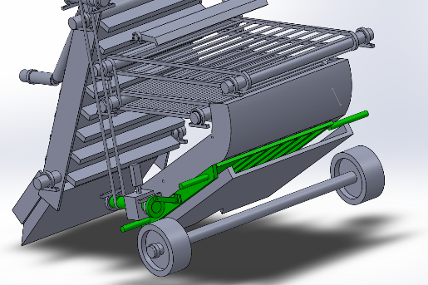
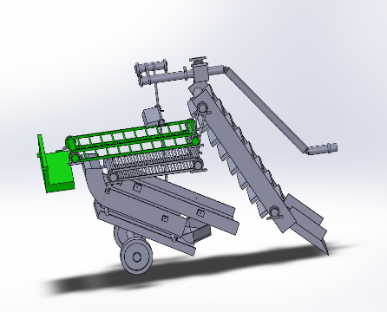
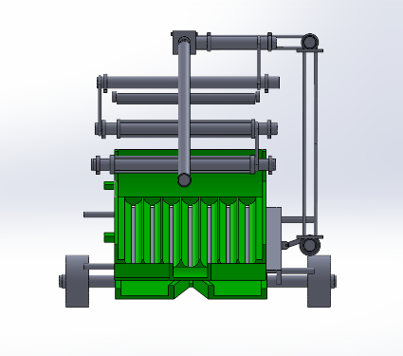
Benefits of our Product
Introduction of Slider Crank Mechanism which involves a number of plane blades attached to single crank instead of the conventional gear mechanism for cutting of leaves improves the mechanical efficiency, reduces the cost and also reduces the manufacturing complexity of the component.
Use of the harvested space of the farm to systematically lay down the separated onions and leaves.
Single machine which can independently and separately carry out the harvesting of onions and cutting of leaves which incorporates a provision for Curing of onions.
The product incorporates an efficient way for the disposal of big lumps of soil.

Slide 14
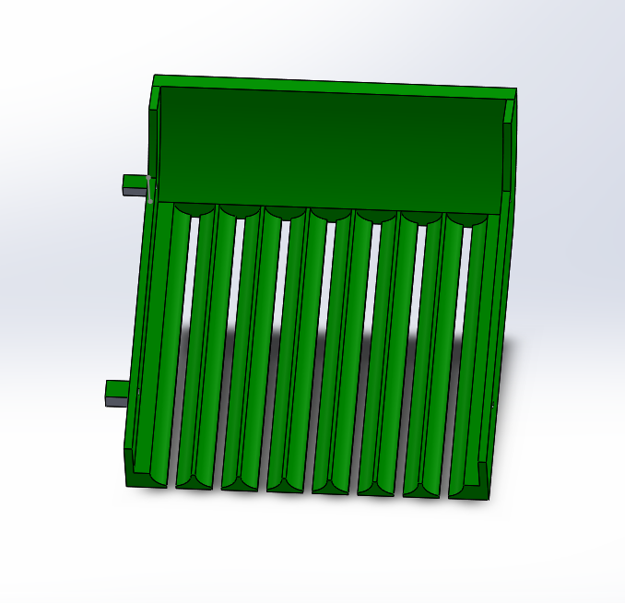
DRAWBACKS OF THE PRODUCT / OPTIMIZATION POSSIBLE
At times, due to less vibration the lumps of soil may not break into very fine particles and may not separate through the pores of the Separator.
Inclusion of Provision of a Sorting machine for the onions can be possible.
In the Second stage, i.e. the cutting of leaves, the onions need to go through the entire process again which can be avoided.
At times, the onion may not change its orientation in a way that its leaves come out of the groove, which may result in some leaves not being cut, thus, reducing the efficiency.

Slide 15
Design Report
(Calculations per Acre of Land)
Rate of work done on the belt | P₁ | 10.639 kW
Max. Power reqd. for cutting | P₂ | 48.467kW
Total Power required | P | 69.745kW
Mass of fuel required | ṁ_{f} | 0.00051kg/s = 0.3 kg/min
Total Fuel required | M_{f} | 7.5kg
Total Volume of Fuel required | V_{f} | 9L
Total Cost | C | ₹720/-

Slide 16
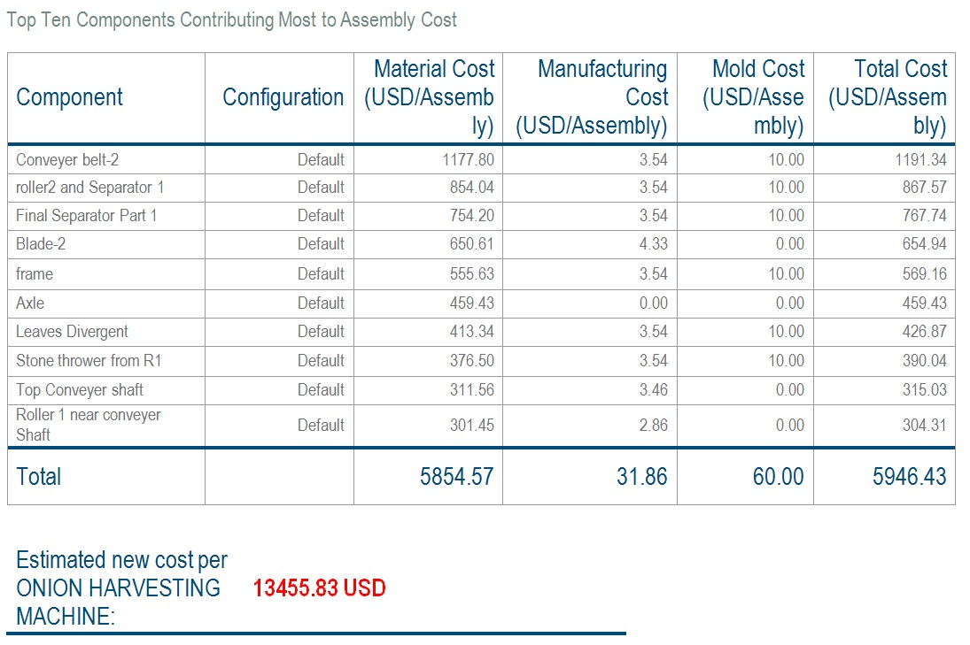
Cost Report

Slide 17
Return On Investment Report
Profit earned by owner | ₹2800/Acre
Profit earned by owner in 10years | ₹92.7lakhs
Maintenance cost | ₹2.7Lakhs
Net Profit earned by owner in 10years | ₹90Lakhs
ROI | 8
Profit earned by Farmer | ₹4000/Acre

Slide 18
References -
1 - Chickering, Earnest E. "Harvester for onions and the like." U.S. Patent No. 2,531,379. 28 Nov. 1950.
2 - James, Frank C. "Onion harvesting machine." U.S. Patent No. 3,451,485. 24 Jun. 1969.
3 - Hiroshi, Tateyama. "Onion harvester machine." U.S. Patent No. 2,625,781. 20 Jan. 1953.
4 - SOLTANABADİ, M. H., ABDOLAHPUR, S., & TAKİ, O. (2012). The Effects of Loading Conditions on Strength and Energy Requirement for Onion Leaf Removing. International Journal of Natural & Engineering Sciences, 6(3).
5 - Gomaa, A. E., Mohamed, H. H., El Gwady, A. A., & Al-Aseebee, M. D. (2014). Evaluation of Tractor Diesel Engine Performance using Biodiesel from Three Different Individual Sources. Misr J. Ag. Eng, 31(2), 403-424.
6 -El-Ghobashy, H., Bahnasawy, A. H., Ali, S. A., Afify, M. T., & Emara, Z. (2012). Development and evaluation of an onion peeling machine. Misr J. Agric. Eng, 29(2), 663-681
7 - Dabhi, M., & Patel, N. (2017). Physical and mechanical properties of Talaja red onion cultivar. Bioprocess Engineering, 1(4), 110-114.

Slide 19
All the Reports that have been mentioned in the above slides are the results of calculations performed. The Reports showing the entire detailed calculations have been submitted separately in a folder. Please do refer to that for detailed analysis.
This brings us to the end of the presentation of the ONION HARVESTING MACHINE.
Through this presentation, we have tried to present our product in a very simple and easy to understand manner.
Thank you for giving us your precious time and going through the entire presentation.
-Made by
Team RAHI

